Slide 1
FullStack Web Camp 2015
Presented by Microsoft

Slide 2
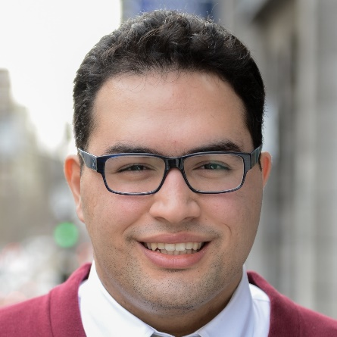



Your Instructors
Rami Sayar
Technical Evangelist | Microsoft Canada
Catch him on:
Canadian Developer Connection blogs.msdn.com/cdndevs
RamiSayar.com
rami.sayar@microsoft.com
@ramisayar
ca.linkedin.com/in/ramisayar

Slide 3
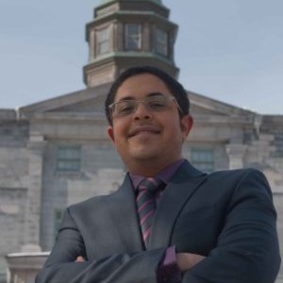
Your Instructors
George Azmy
Scala/Angular Dev | Morgan Stanley
Catch him on:
Twitter - @grgazmy
grg@azmy.ca
@grgazmy

Slide 4
Full Stack Web Cam Agenda
Session | Time | Speaker
Keynote | 9:00 - 9:30 | Rami Sayar
Introduction to Node.JS & Express | 9:30 - 10:15 | Rami Sayar
Break | 10:15 - 10:30 | FREE SNACKS!
HOL - Building REST APIs with Node.JS | 10:30 - 11:45 | Rami Sayar
HOL - Deploying Node Apps to Azure Web Sites | 11:45 - 12:30 | Rami Sayar
Lunch | 12:30 - 1:30 | FREE LUNCH!
HOL - Azure DocumentDB & CDN | 1:30 - 2:15 | Rami Sayar
Introduction to AngularJS | 2:15 - 3:00 | George Azmy
Break | 3:00 - 3:15 | FREE SNACKS!
Advanced AngularJS | 3:15 - 4:00 | George Azmy
HOL - Using AngularJS to Create a SPA & Connecting your Node App via REST API | 4:00 – 4:45 | George Azmy

Slide 5
What is Full Stack Web Development?

Slide 6
Web Trends
Convergence of Platforms
JavaScript Everywhere – IoT, Web, Apps, etc.
JSON Everywhere!

Slide 7
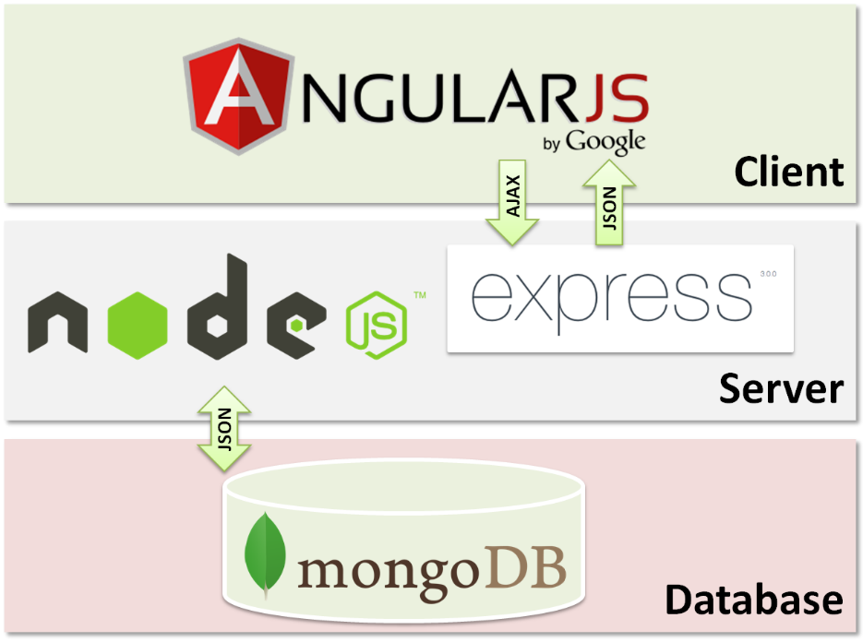
Full Stack Web Developers
Developers who can build web apps from beginning to end, typically using JavaScript and a MEAN stack exclusively.

Slide 8

Full Stack Web Developers
Alternatives to the MEAN stack:

Slide 9

Time for the evaluation
http://aka.ms/FullstackMontrealEval

Slide 10
Let’s Get Started!

